Slide 1

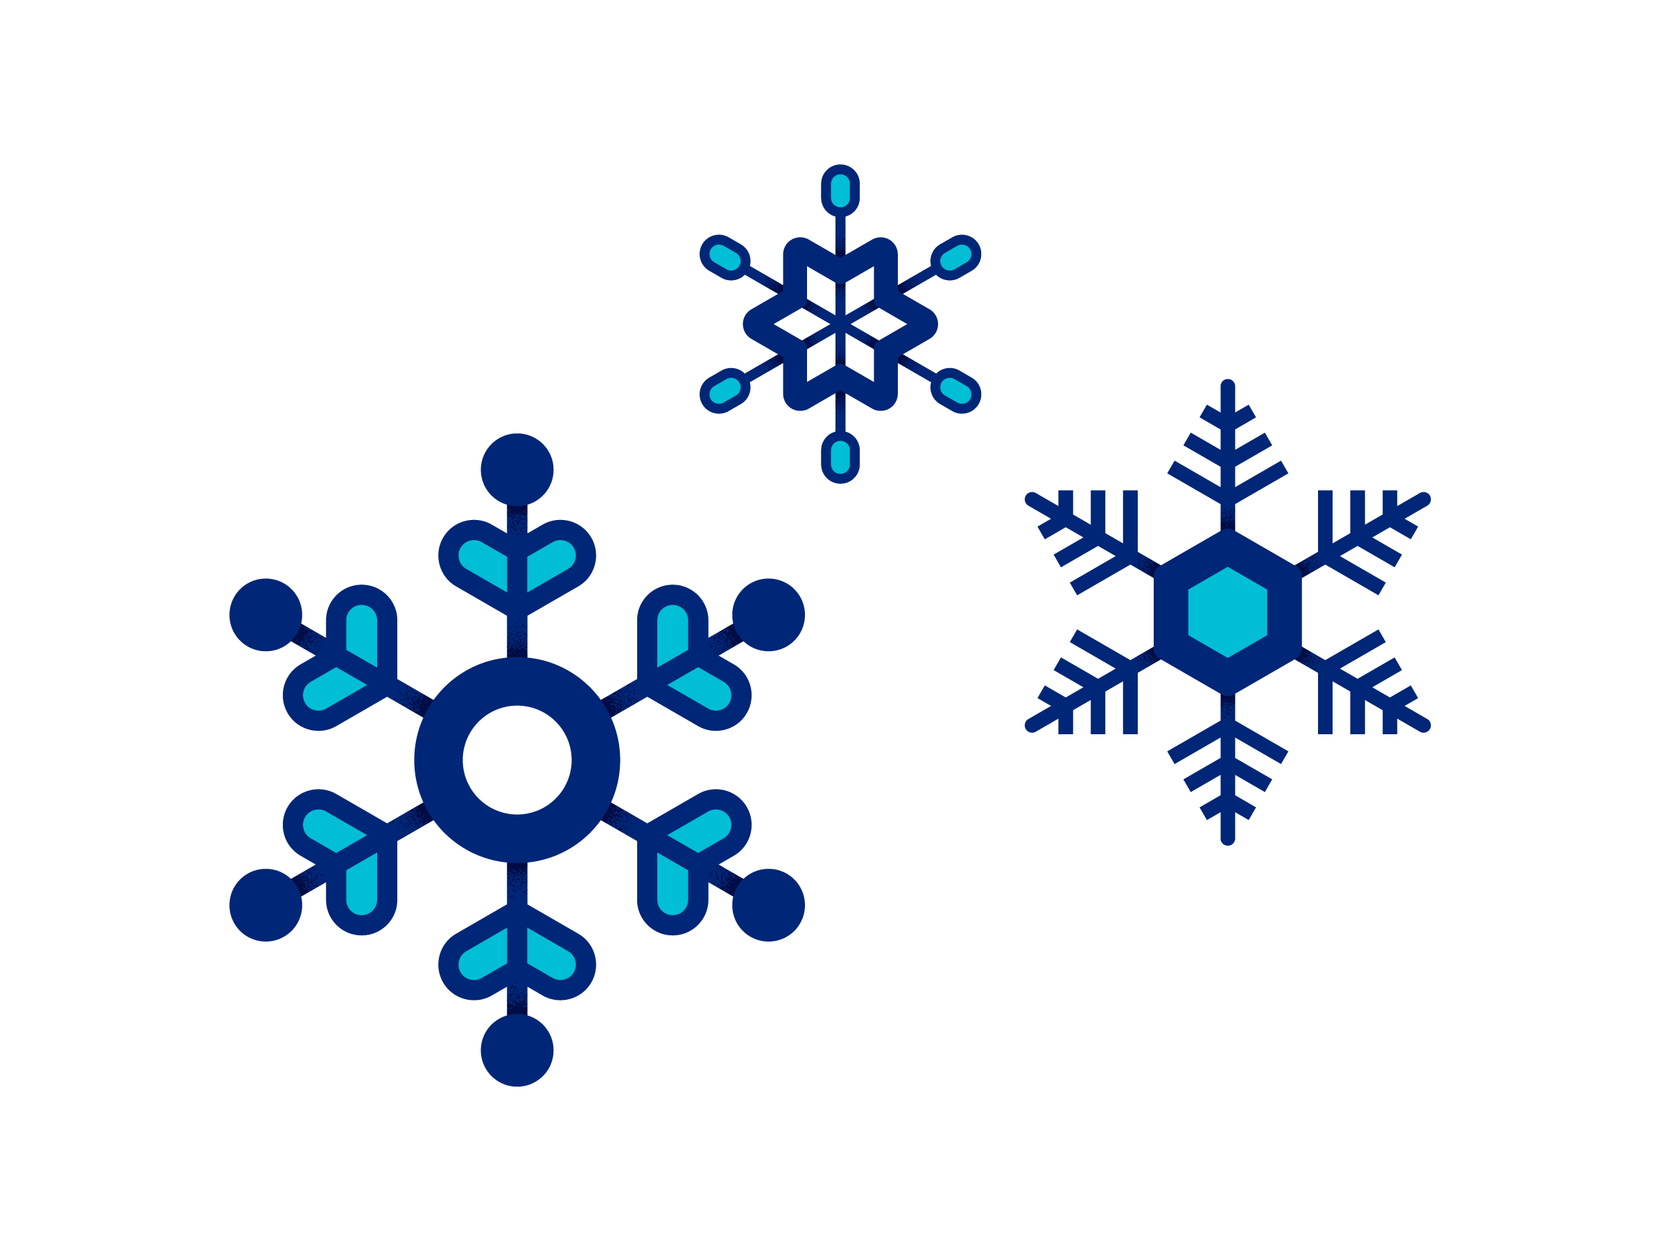
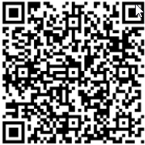
Maintain and Gain Challenge
Shifting away from a traditional weight maintenance challenge in December may help you focus on overall well-being. This can support many health gains, especially during a festive, yet stressful time of year. During this two-week challenge, identify activities you are already doing to support your well-being, and challenge yourself to complete two new activities each week. Upon completing, reflect on your holiday gains, then email a picture of this completed tracker to leah_hammel@uhc.com or scan the QR code below to submit the challenge completion form.
Week 1: Emotional Well-Being Maintains and Gains | Week 2: Nutrition & Movement Maintains and Gains
List 2 things you are already doing for your emotional well-being that you would like to maintain: 1.______________________________________________________________ 2.______________________________________________________________ List 2 things you would like to add/start doing for your emotional well-being: 1.______________________________________________________________ 2.______________________________________________________________ tip: Aim to set a duration of time if applicable, i.e., for 15 minutes, 3 times out of the week | List 2 things you are already doing for your nutrition & movement that you’d like to maintain: 1.______________________________________________________________ 2.______________________________________________________________ List 2 things you would like to add/start doing for your nutrition & movement: 1.______________________________________________________________ 2.______________________________________________________________ tip: Aim to set a duration of time if applicable, i.e., for 15 minutes, 3 times out of the week
Need ideas? See the next page!
Self Reflection Think back on the last 2 weeks. What were you able to gain in the process of focusing on your self-care? How did you feel? What would you like to continue to focus on?
Need help? For questions, contact your Health Engagement Coordinator: Leah Hammel. leah_hammel@uhc.com
Challenge
Completion
Form
NAME: __________________________ LOCATION: __________________________

Slide 2
Maintain and Gain Challenge Activity examples
Emotional well-being activity examples
Prioritizing family time
Shopping
Giving
Volunteering
Reading
Gathering with friends or family
Creating memories
Resting and relaxing
Focusing on quality sleep
Allowing a mindset of gratitude
Embracing positivity
Practicing self-compassion
Creating new traditions
Deep breathing
Meditating
Performing random acts of kindness
Enjoying nature
Engaging in a hobby
Nutrition and movement activity examples
Eating mindfully (paying attention to textures, flavors, and smell of food)
Focusing on how movement makes you feel
Reframing negative thoughts around food choices
Maintaining adequate hydration
Putting the scale away
Prioritizing balanced meals and snacks
Cooking together with a loved one
Taking a holiday walk to view celebratory lights
Reflecting on where food has come from and who helped bring it to the table
Ice skating
Creating new traditions around food
Noticing the cold, fresh air
Embracing joy
Visiting a Christmas tree farm
Dancing to a favorite playlist

Slide 3




Additional resources United at Work presentations
Click images to watch presentation

